Slide 1
GST (Goods and Services Tax)
Biggest Tax Reform Since Independence

Slide 2
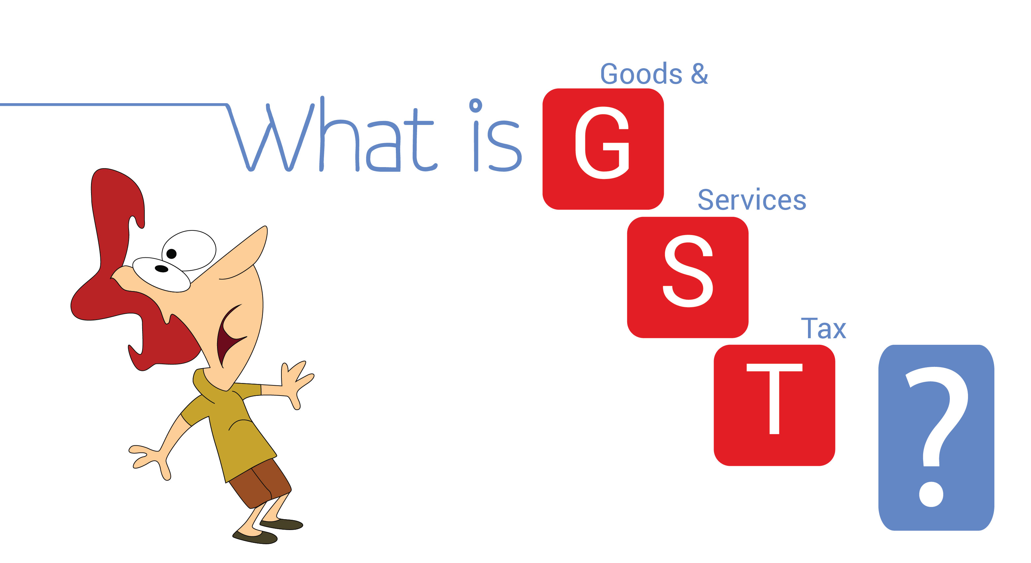
GST
Goods and service tax (GST) is a comprehensive tax levy on manufacture, sale and consumption of goods and service at a national level.
Goods and Services Tax Law in India is a comprehensive, multi-stage, destination-based tax that is levied on every value addition.
GST is a comprehensive, multistage, destination-based tax.
Gst includes many state and central level indirect taxes.

Slide 3
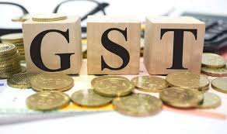
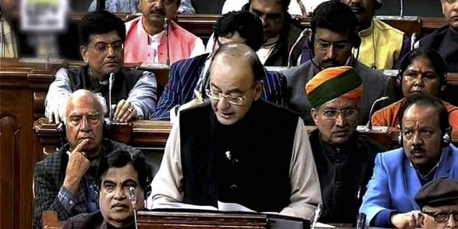
Implementation
GST was Launched Midnight on 1 July 2017
The One Hundred and First Amendment of the Constitution of India
Historic Midnight and attended by high profile guests.

Slide 4
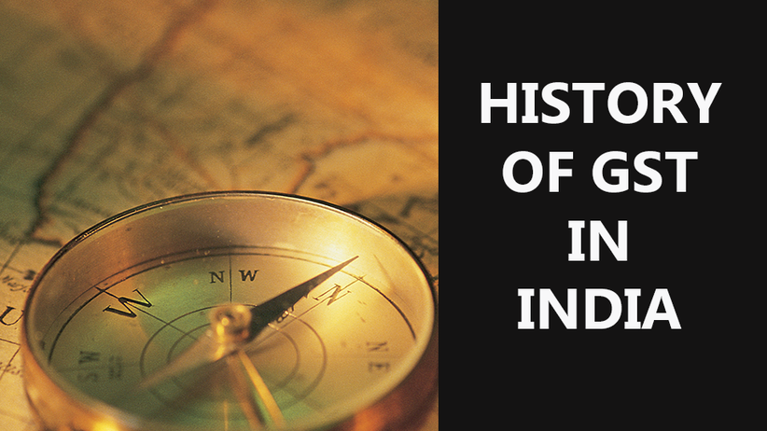
History
1999: A single common "Goods and Services Tax (GST)" was proposed.
2002: The Vajpayee government formed a task force under Vijay Kelkar to recommend tax reforms.
2005: The Kelkar committee recommended rolling out GST
2006 : First time introduced concept of GST and announced the date of its implementation in 2010
2007: F.M. Announced introduction of GST from 1 April 2010 in Budget
2009:The Government came out with a First Discussion Paper on GST .
2011: Introduced the 115th Constitution Amendment (GST) Bill in the year 2011.

Slide 5
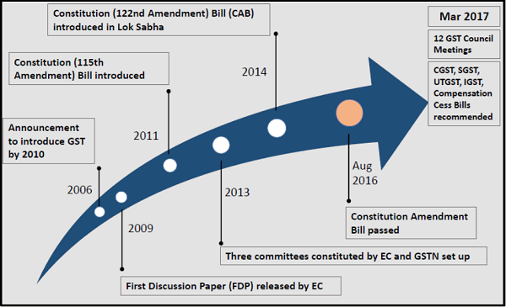
2013: Several States and Gujarat Chief Minister Narendra Modi raised objections.
2014 : The consequential dissolution of the 15th Lok Sabha, the GST Bill approved by the standing committee for reintroduction – lapsed.
2014: The new Finance Minister Arun Jaitley introduced the GST Bill again in the Lok Sabha.
2015: Another deadline of 1 April 2017 to implement GST was set.
2016: In May, Lok Sabha passed the Constitution Amendment Bill, paving way for GST
2016: In August, Rajya Sabha passed the bill.
2017: GST Council meet 12 times and Approves all bills and lok Sabha passes all 4 supplementary GST Bills
2017: Goods and Services Tax was launched all over India with effect from 1 July 2017

Slide 6
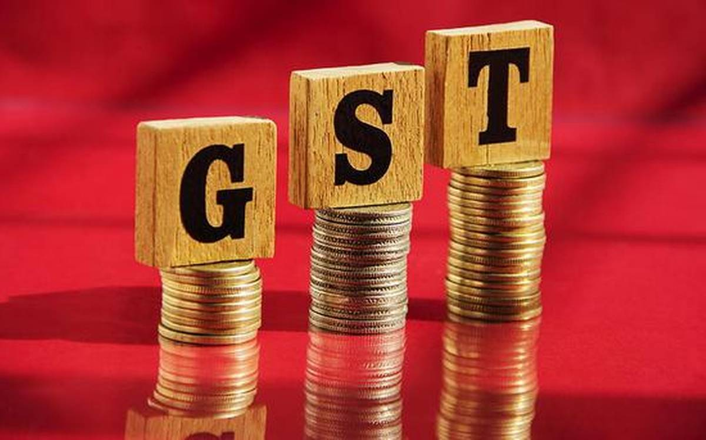
Need For GST
Due to multiple rates there are multiple forms
As a developing country, india needs a transparent & unambiguous tax structure
Increased tax collections due to wider tax base and better compliance
Helping as a weapon against corruption
GST encourages an unbiased tax structure that is neutral to business processes, business models, organization structure, product substitutes and geographical locations
High transaction cost in the hands of the tax payers

Slide 7
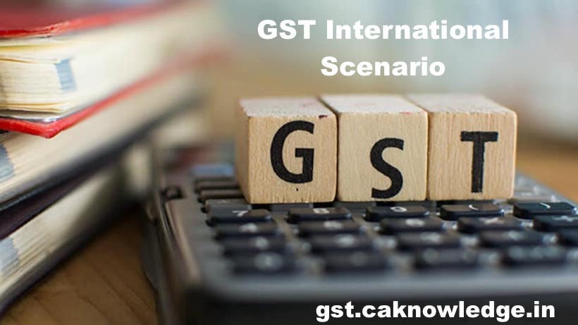
GST Global Scenario
More than 160 countries have already introduced GST/National VAT.
France was the first country to introduce GST system in 1954.
Typically it is a single rate system but two/three rate systems are also prevalent.
Canada and Brazil alone have a dual VAT.
Standard GST rate in most countries ranges between 15-20%.
Some of the countries with GST include Canada, Vietnam, Australia, Singapore, United Kingdom, Monaco, Spain, Italy, Nigeria, Brazil, South Korea, and India.

Slide 8
Main components of the GST tax reform

Slide 9
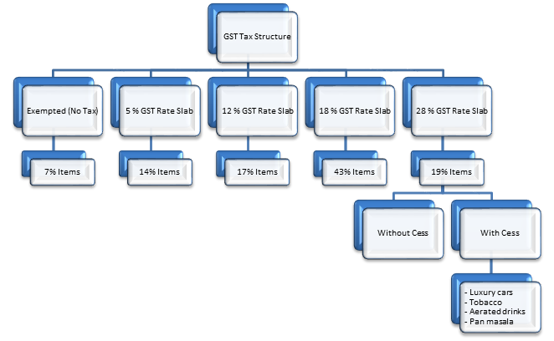
GST RATE SLAB
GST has been structured in a way that essential services and food items are placed in the lower tax brackets, while luxury services and products have been placed in the higher tax bracket.
The GST council has fitted over 1300 goods and 500 services under four tax slabs of :
5%, 12%, 18% and 28% under GST.

Slide 10
Taxes that were replaced by GST
Central Taxes Replaced by GST-
Additional duties of excise
Central Excise Duty
Excise duty levied under Medicinal & Toiletries Preparation Act
Additional duties of Excise levied under Textiles & Textile Products
Additional duties of Customs(CVD & SAD)
Service Tax
Surcharges & Cesses
Central Sales tax
At the state level below mentioned taxes have been replaced by GST-
State VAT/Sales Tax
Central Sales Tax
Purchase Tax
Entertainment Tax(Other than those levied by local bodies)
Luxury Tax
Entry Tax(All Forms)
Taxes on lottery, betting & gambling
Surcharges & Cesses
Taxes on advertisements

Slide 11
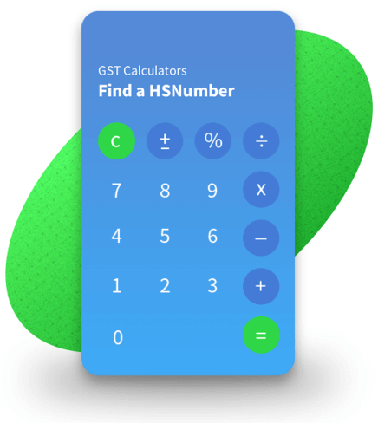
HSN Code:
What is HSN Code?
HSN code stands for “Harmonized System of Nomenclature”. This system has been introduced for the systematic classification of goods all over the world. HSN code is a 6-digit uniform code that classifies 5000+ products and is accepted worldwide. It was developed by the World Customs Organization (WCO) and it came into effect from 1988.
Almost all goods in India are classified using the HSN classification code, which facilitates the use of HSN numbers for calculations of the Goods and Service Tax (GST). The number is currently being used to categorize goods to compute VAT (Value Added Tax).

Slide 12
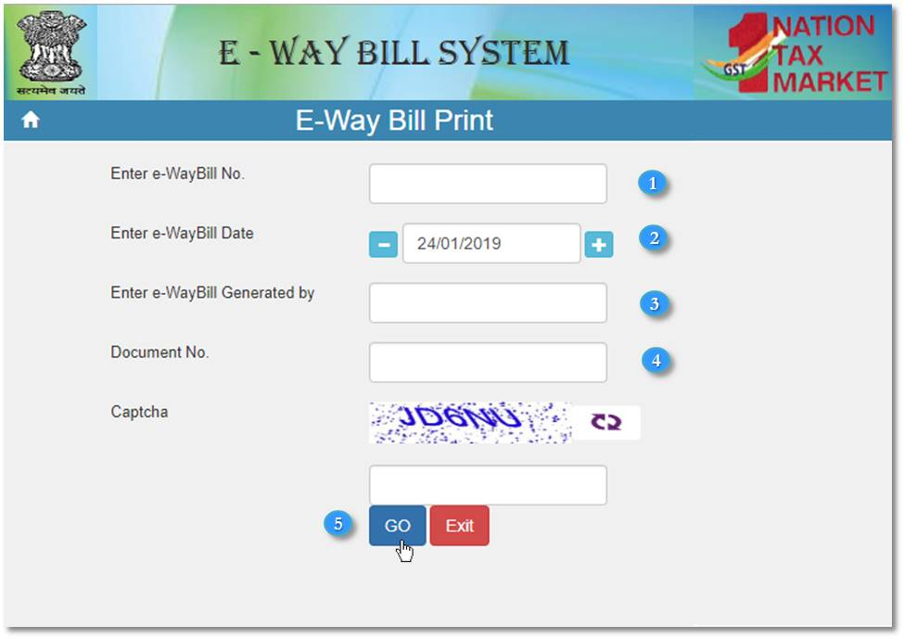
eWay Bill
EWay Bill is an Electronic Way bill for movement of goods to be generated on the eWay Bill Portal. A GST registered person cannot transport goods in a vehicle whose value exceeds Rs. 50,000 (Single Invoice/bill/delivery challan) without an e-way bill that is generated on ewaybillgst.gov.in.
When an eway bill is generated, a unique Eway Bill Number (EBN) is allocated and is available to the supplier, recipient, and the transporter.

Slide 13
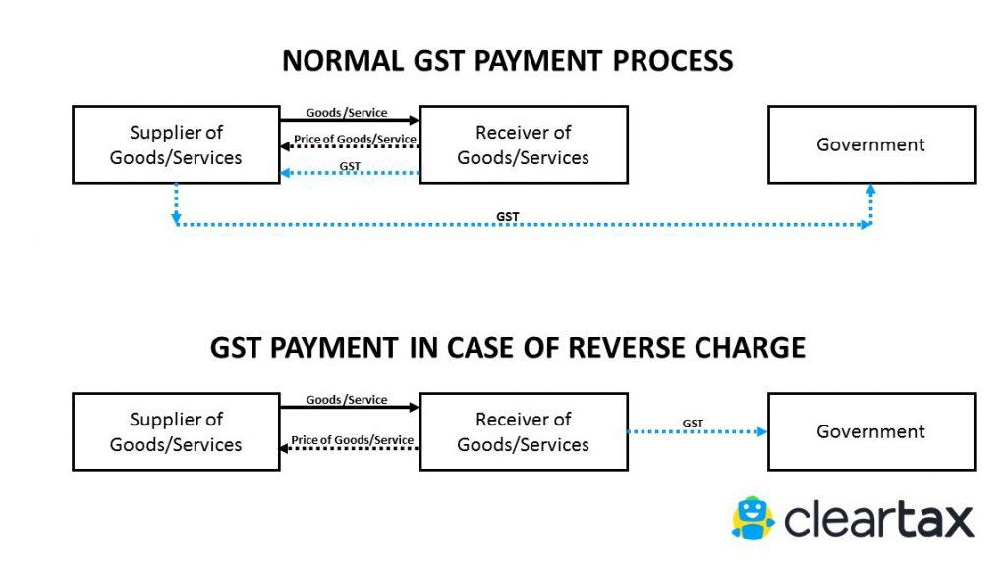
Reverse charge mechanism
Normally, the supplier of goods or services pays the tax on supply. In the case of Reverse Charge, the receiver becomes liable to pay the tax, i.e., the chargeability gets reversed.
If a vendor who is not registered under GST, supplies goods to a person who is registered under GST, then Reverse Charge would apply. This means that the GST will have to be paid directly by the receiver to the Government instead of the supplier.

Slide 14
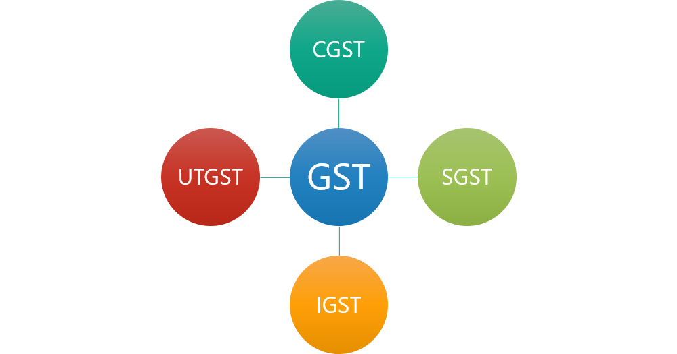
Types of GST
There are four different types of GST as listed below:
The Central Goods and Services Tax (CGST)
The State Goods and Services Tax (SGST)
The Union Territory Goods and Services Tax (UTGST)
The Integrated Goods and Services Tax (IGST)

Slide 15
Thank You

